Slide 1


Data Science Bootcamp
#1 rated Coding and Data Science Program in all of Orange County, Los Angeles, and the Inland Empire.
Prep Course Introduction - Statistics

Slide 2


Statistics
Statistics is the discipline that is concerned with the collection, organization, analysis, interpretation, and presentation of data.
Source: https://en.wikipedia.org/wiki/Statistics
Statistics is a science of collecting and analyzing data taken from a sample population
Notes:
The goal is to turn data into knowledge

Slide 3
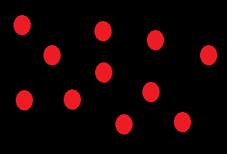
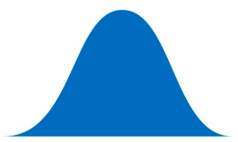
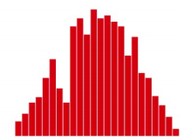
Population vs Sample
Population
Population
Sample
Sample
Notes:
the first message for statistical thinking is, statistics derives knowledge from sample regarding the population by carefully conducted collection and data
Example of US election survey and its results

Slide 4
Population vs Sample
Sample
Sample is the specific group that you collect data from. To be a truly random sample, every subject in your target population must have an equal chance of being selected in your sample.
Population
Population is the broader group of people to whom you intend to generalize the results
Notes:
the first message for statistical thinking is, statistics derives knowledge from sample regarding the population by carefully conducted collection and data
Example of US election survey and its results
the first message for statistical thinking is, statistics derives knowledge from sample regarding the population by carefully conducted collection and data

Slide 5
Population vs Sample
N = Total population
n = Total sample from population

Slide 6
Population vs Sample
Sample A subset from a larger data set.
Population The larger data set or idea of a data set.
N (n) The size of the population (sample).
Random sampling Drawing elements into a sample at random.
Simple random sample The sample that results from random sampling without stratifying the population.
Sampling with replacement and without replacement

Slide 7
Data
Data Generation
Data Collection
Knowledge
Business Intelligence
Solutions
Notes:
We have little control on data generation
From generated data we gather data to analysis
We want to drive knowledge, business intelligence and solution based on our data

Slide 8
Data
Assumptions about data sampling
Randomization
Measurements of the data
Independence between variables

Slide 9
Bootstrap and resampling
Bootstrap sample A sample taken with replacement from an observed data set.
Resampling The process of taking repeated samples from observed data; includes both bootstrap and permutation (shuffling) procedures.
Notes:
Multiple samples are combined and the sampling may be done without bootstrap

Slide 10
Data
5
Data is usually a number, for a unit of observation and has a context
Notes:
Data is usually a number, for a unit of observation and has a context
Does 5 mean Age of 5 - years
Height of the person 5 feet
Weight of the person 5 pounds
Does it mean 5ml of rain

Slide 11
Type of data
Types of variable
Quantitative variables
Qualitative variables
Date and time

Slide 12
Quantitative Variable
Types of Quantitative variable
Continuous variables
Discrete variables

Slide 13
Qualitative Variable
Types of Qualitative variable
Ordinal variables
Nominal variables

Slide 14
Fundamental Ideas
Variance
Estimates of Location
Uncertainty
Probability

Slide 15
Statisticians and Data scientists
A sample to a statistician means a collection of rows.
Data scientists will use the term sample for a single row

Slide 16
Statisticians and Data scientists
Statistician, predictor variables are used in a model to predict a response or dependent variable.
For a data scientist, features are used to predict a target.

Slide 17
Centrality Measures/ Descriptive statistics
Central tendency measures, which capture the center around which the data is distributed.
Variation or variability measures, which describe the data spread, i.e. how far the measurements lie from the center.

Slide 18
Central tendency measures
Mean
Arithmetic mean
Weighted mean
Geometric mean
Median
Mode
Notes:
geometric mean is a mean or average, which indicates the central tendency or typical value of a set of numbers by using the product of their values (as opposed to the arithmetic mean which uses their sum).

Slide 19
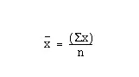
Mean
Average
μ = Mean of population
x = Mean of sample

Slide 20
Mean
Let’s write a function to calculator mean of a given dataset
1, 2, 4, 5, 5, 7, 8, 9

Slide 21
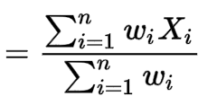
Weighted Mean
μ = Mean of population
x = Mean of sample

Slide 22
Weighted Mean
Let’s write a function to calculator mean of a given dataset
Weighted Values Student 1 Students 2
HW | 15%
Quiz | 15%
Mid term | 35%
Final | 35%
HW | 78
Quiz | 70
Mid term | 89
Final | 94
HW | 100
Quiz | 97
Mid term | 76
Final | 79

Slide 23
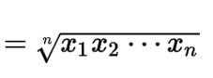
Geometric Mean
μ = Mean of population
x = Mean of sample

Slide 24
Geometric Mean
Let’s write a function to calculate geometric mean of a given dataset
1, 2, 4, 5, 5, 7, 8, 9

Slide 25
Median
Any number, y, for which 50% of the data is <= y and 50% is >= y
1, 2, 4, 5, 5, 8, 9
1, 2, 4, 5, 6, 7, 8, 9 → y 𝞊 [5, 6] (often say y=5.5)

Slide 26
Mode
The most frequent number in the dataset
1, 2, 4, 5, 5, 8, 9
1, 2, 4, 5, 5, 6, 6, 8, 9 → multimodal

Slide 27
Estimates of Location
(Sample) Mean: The sum of all values divided by the number of values. Synonyms: average
Median: The value such that one-half of the data lies above and below. Synonyms: 50th percentile
Mode: The most frequent value
Outlier: A data value that is very different from most of the data. Synonyms: extreme value

Slide 28
Estimates of Location
Mean: The sum of all values divided by the number of values. Synonyms: average
Weighted mean: The sum of all values times a weight divided by the sum of the weights. Synonyms: weighted average
Geometric mean is calculated by multiplying all numbers and then taking the nth root of that number (where n=number of numbers).
Trimmed mean: The average of all values after dropping a fixed number of extreme values. Synonyms: truncated mean

Slide 29
Variability measures
Variance
Standard Deviation
Coefficient of Variation
Interquartile Range
Notes:
geometric mean is a mean or average, which indicates the central tendency or typical value of a set of numbers by using the product of their values (as opposed to the arithmetic mean which uses their sum).

Slide 30
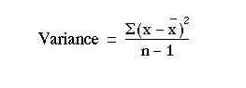
Variance
Spread of data around the mean
𝛔² = Variance of population
S² = Variance of sample
Notes:
Why divide by n-1 : https://www.willemsleegers.com/post/2020/08/05/why-divide-by-n-1/
Bias and unbias : https://www.merriam-webster.com/dictionary/unbiased

Slide 31
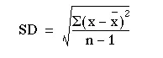
Standard deviation
Square root of variance
𝛔 = Standard deviation of population
s = Standard deviation of sample

Slide 32
Coefficient of variation
Compare two datasets which operate on different scales i.e miles and kilometers
Coefficient of variation = Standard deviation / Mean
Miles = 3, 4, 4.5, 3.5
Kms = 4.828, 6.437, 7.242, 5.632

Slide 33
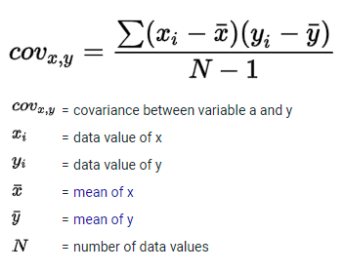
Covariance
Covariance if two values are moving in the same direction
Age | Internet use
18 | 125
25 | 120
40 | 100
50 | 70

Slide 34
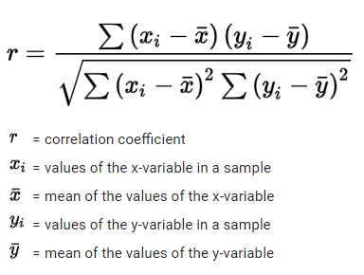
Correlation coefficient
r = Covariance(x,y) / S(x) * S(y)
1 is perfect positive correlation
-1 is perfect negative correlation
0 means no correlation

Slide 35
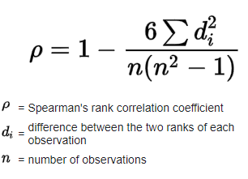
Spearman Correlation coefficient
The Spearman's rank-order correlation is the nonparametric version of the Pearson product-moment correlation. Spearman's correlation coefficient, (ρ, also signified by rs) measures the strength and direction of association between two ranked variables.
Notes:
https://www.youtube.com/watch?v=FNVdFV4fLfs

Slide 36
Variation or variability measures
N-th Quantile
Point at which N% of the data lies below that point
1, 3, 5, 6, 7 → 3 is 20% quantile, 6
Interquartile Range (IQR)
Interquartile range: The range between the 75th percentile and the 25th percentile.

Slide 37
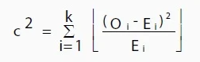
Chi squared statistic
A chi-square test for independence compares two variables in a contingency table to see if they are related.
Notes:
Chi squared statistic = https://www.youtube.com/watch?v=5Nrq_jqu9Ao

Slide 38
Association between quantitative variables
Statistic used to measure association between quantitative variables is called correlation. It is a single number of statistics for linear association. Correlation is a measure of linear association.
Notes:
Odd’s ratio = p1/(1-p1) / p2/(1-p2)
= 2.846 / 0.219
= 12.995

Slide 39
Data Structures
Rectangular data (Structured data)
Unstructured data
Time series data
Spatial data
Graph (or network) data
Notes:
Graph refers to connections among entities, and to the underlying data structure. In statistics, graph is used to refer to a variety of plots and visualizations,

Slide 40
Variability Metrics
Deviations: The difference between the observed values and the estimate of location. Synonyms errors, residuals
Variance: The sum of squared deviations from the mean divided by n – 1 where n is the number of data values. Synonyms mean-squared-error
Standard deviation: The square root of the variance.

Slide 41
Variability Metrics
Mean absolute deviation: The mean of the absolute value of the deviations from the mean.
Median absolute deviation from the median: The median of the absolute value of the deviations from the median.

Slide 42
Variability Metrics
Interquartile range: The difference between the 75th percentile and the 25th percentile. Synonyms IQR

Slide 43
Estimates of Location
Median: The value such that one-half of the data lies above and below. Synonyms 50th percentile
Weighted median: The value such that one-half of the sum of the weights lies above and below the sorted data.

Slide 44
Central limit theorem
Sample statistic A metric calculated for a sample of data drawn from a larger population.
Data distribution The frequency distribution of individual values in a data set.
Sampling distribution The frequency distribution of a sample statistic over many samples or resamples.
Central limit theorem The tendency of the sampling distribution to take on a normal shape as sample size rises.
Standard error The variability (standard deviation) of a sample statistic over many samples (not to be confused with standard deviation, which, by itself, refers to variability of individual data values).

Slide 45
Central limit theorem
Means drawn from multiple samples will resemble the familiar bell-shaped normal curve (see “Normal Distribution”), even if the source population is not normally distributed, provided that the sample size is large enough.
Standard error can be estimated using a statistic based on the standard deviation s of the sample values, and the sample size n.
SE = s/(n)^1/2

Slide 46
Key terms
Error The difference between a data point and a predicted or average value.
Standardize Subtract the mean and divide by the standard deviation.
z-score The result of standardizing an individual data point.
Standard normal A normal distribution with mean = 0 and standard deviation = 1
Tail The long narrow portion of a frequency distribution, where relatively extreme values occur at low frequency.
Skew Where one tail of a distribution is longer than the other.

Slide 47
Central tendency measures
Mean
Arithmetic mean
Geometric mean
Median
Mode

Slide 48
Variation or variability measures
Variance
Standard deviation
Range
Interquartile Range (IQR)

Slide 49
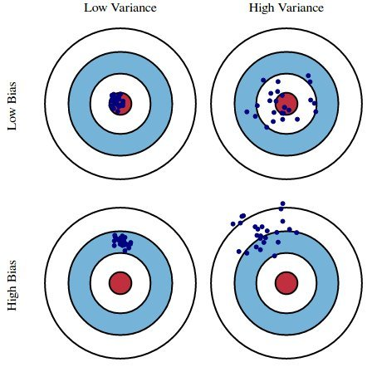
having an expected value equal to a population parameter being estimated
Bias vs Variance

Slide 50
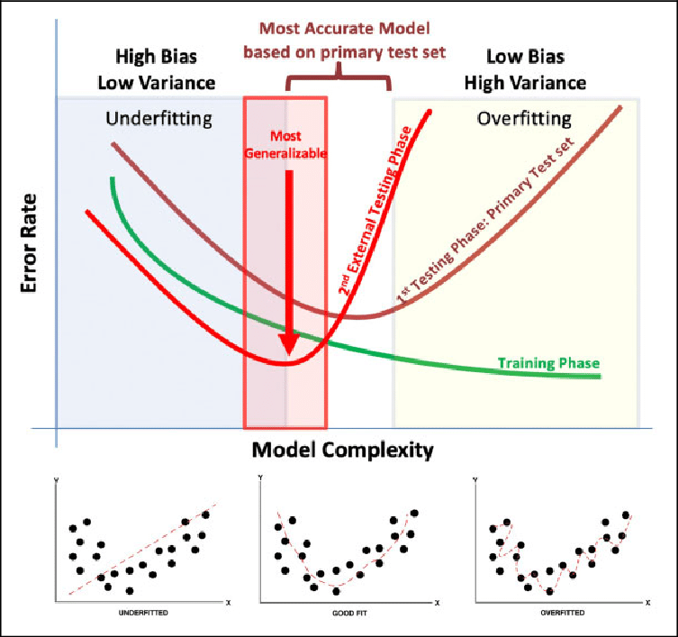
Bias vs Variance

Slide 51
DATA SCIENCE ADDITIONAL READINGS
ASA Whitepaper: Discovery with Data: Leveraging Statistics with Computer Science to Transform Science and Society. http://www.amstat.org/policy/pdfs/BigDataStatisticsJune2014.pdf
A Cartoon Guide to Statistics http://www.amazon.com/Cartoon-Guide-Statistics-Larry-Gonick/dp/0062731025
Naked Statistics http://www.amazon.com/Naked-Statistics-Stripping-Dread-Data/dp/1480590185

